Slide 1
UBUNTU BEVERAGES LTD.
B2B SALES REPORT 2016-2019

Slide 2
OUTLINE
ABOUT US | OUR TEAM
ANNUAL KPI
SALES CHALLENGES
PRODUCT BRAND REVENUE
SALES DATA ANALYSIS USING SQL
SALES DASHBOARD
INSIGHTS
NEXT STEPS - RECOMMENDATIONS

Slide 3
ABOUT US We are UBUNTU, a luxury, high-end beverage STARTUP, FOCUSED ON THE HOSPITALITY INDUSTRY SERVICE TO HUMANITY ONE SIP AT A TIME VIA EXPERTLY CRAFTED COFFE AND PREMIUM WATER BLACK COFFEE ICE CREAM LUXURY WATER
OUR TEAM
AZEEZ GAZAL

Slide 4

ANNUAL KPI
CUSTOMER ACQUISITION AND RETENTION – CA cost reduction
NEW PRODUCT DEVELOPMENT
200M TOTAL SALES TURNOVER ACROSS ALL SALES CHANNELS
INCREASE DELIVERED VOLUMES
PRODUCT MARGINAL IMPROVEMENT – Agile mid-year product redesign.

Slide 5
PRODUCT BRAND REVENUE
VIKTORY GROUND | ILLY GROUND | SPARKLING WATER
304M | 251M | 124M

Slide 6
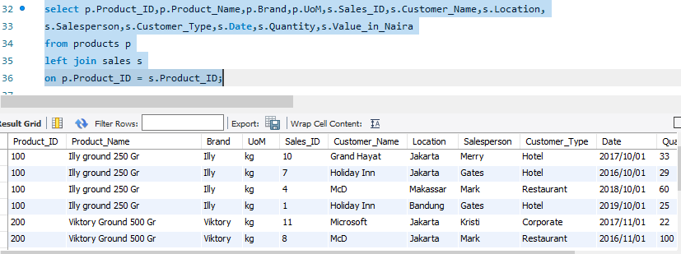
SALES DATASETS ANALYSIS USING SQL
Product and sales datasets combined using SQL Join function

Slide 7
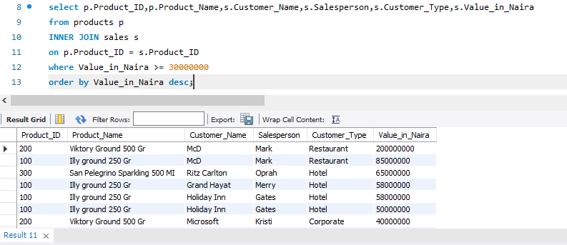
SALES DATASETS ANALYSIS USING SQL
Determining sales values orders of 30m and above across all products and sales channels

Slide 8
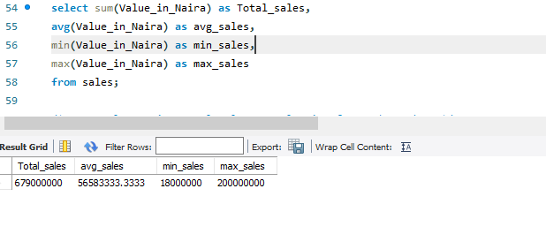
SALES DATASETS ANALYSIS USING SQL
Calculating sum, average, maximum and minimum sales values in the past four financial years

Slide 9
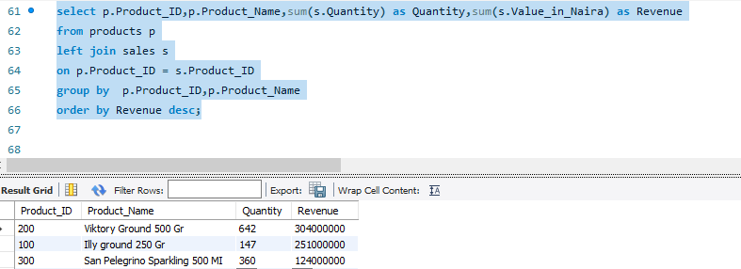
SALES DATASETS ANALYSIS USING SQL
Extracting total sales values and quantity sold for each product

Slide 10
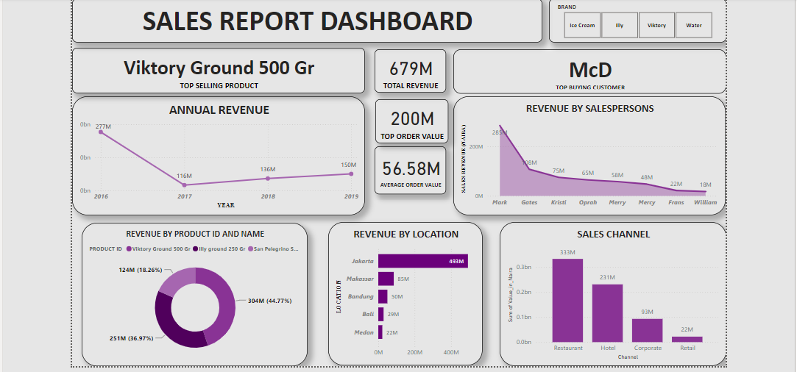

Slide 11

SALES DATA INSIGHTS
ANNUAL REVENUE - Dwindling sales revenue over the years due to strong industry competition
Lopsided Sales revenue across channels.
Viktory Ground 500 Gr sold to McD (Restaurant) for 200 million Naira.
Over-reliance on top brand
Long sales order cycle length
Sales personnel exclusive channel specialization

Slide 12
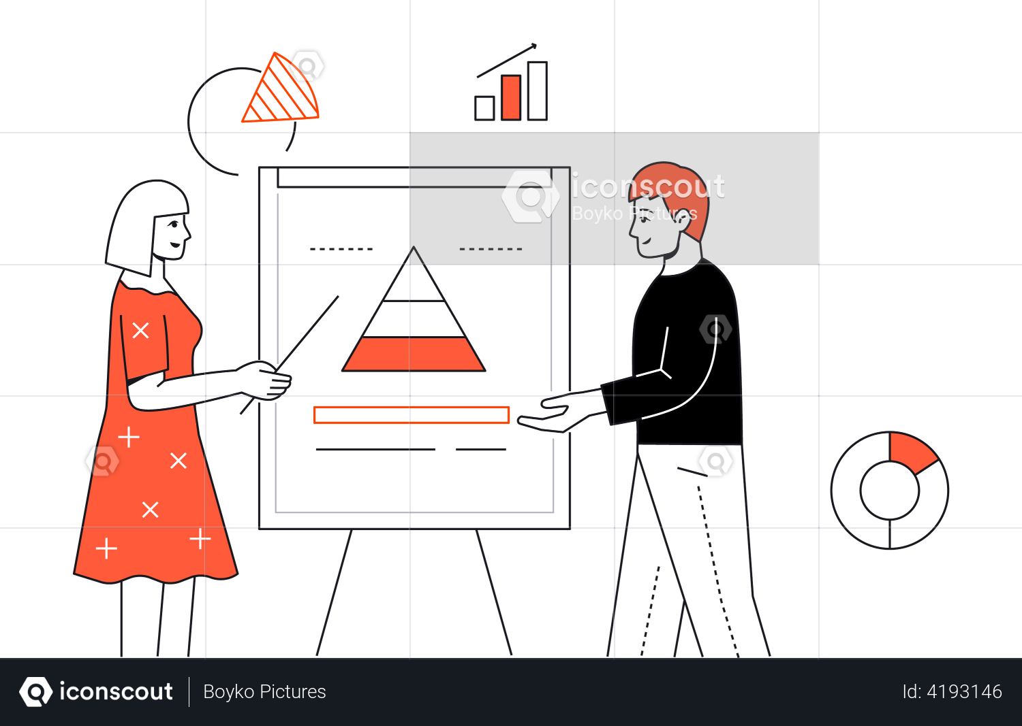
NEXT STEPS – RECOMMENDATIONS [“AGILE”]
CREATE OWN RETAIL RESTAURANT CHAIN – at exclusive locations, enables wider consumer reach and brand impression.
RETAIL E-COMMERCE LAUNCH – Online retail store for developing marketing and brand engagements. Significant step in maintaining market share and brand equity.
TARGETED MARKETING STRATEGIES – During peak sales season, at underperforming sales channels and locations
MOQ – Apply a Minimum order quantity across sales channels
PRICE OFFERINGS – Dynamic price offerings

Slide 13
THANK YOU

Slide 14
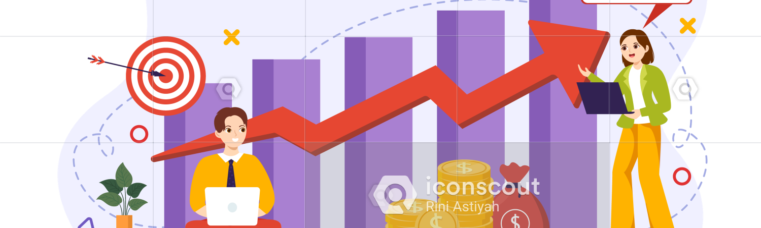
Questions?
MONEY MOVES

